Slide 1
Unit 2

Slide 2
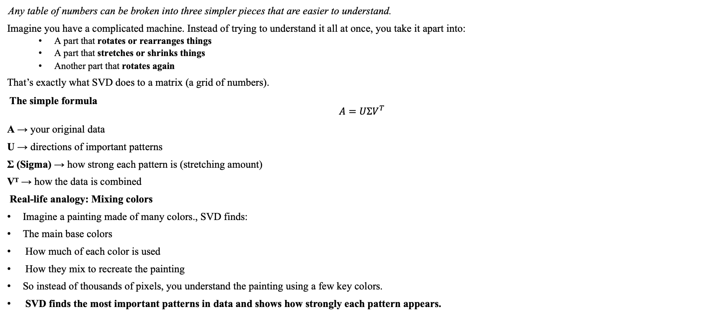
Singular Value Decomposition (SVD)
Any table of numbers can be broken into three simpler pieces that are easier to understand.
Imagine you have a complicated machine. Instead of trying to understand it all at once, you take it apart into:
A part that rotates or rearranges things
A part that stretches or shrinks things
Another part that rotates again
That’s exactly what SVD does to a matrix (a grid of numbers).
The simple formula
$$A=UΣV^{T}$$
A → your original data
U → directions of important patterns
Σ (Sigma) → how strong each pattern is (stretching amount)
Vᵀ → how the data is combined
Real-life analogy: Mixing colors
Imagine a painting made of many colors., SVD finds:
The main base colors
How much of each color is used
How they mix to recreate the painting
So instead of thousands of pixels, you understand the painting using a few key colors.
SVD finds the most important patterns in data and shows how strongly each pattern appears.

Slide 3
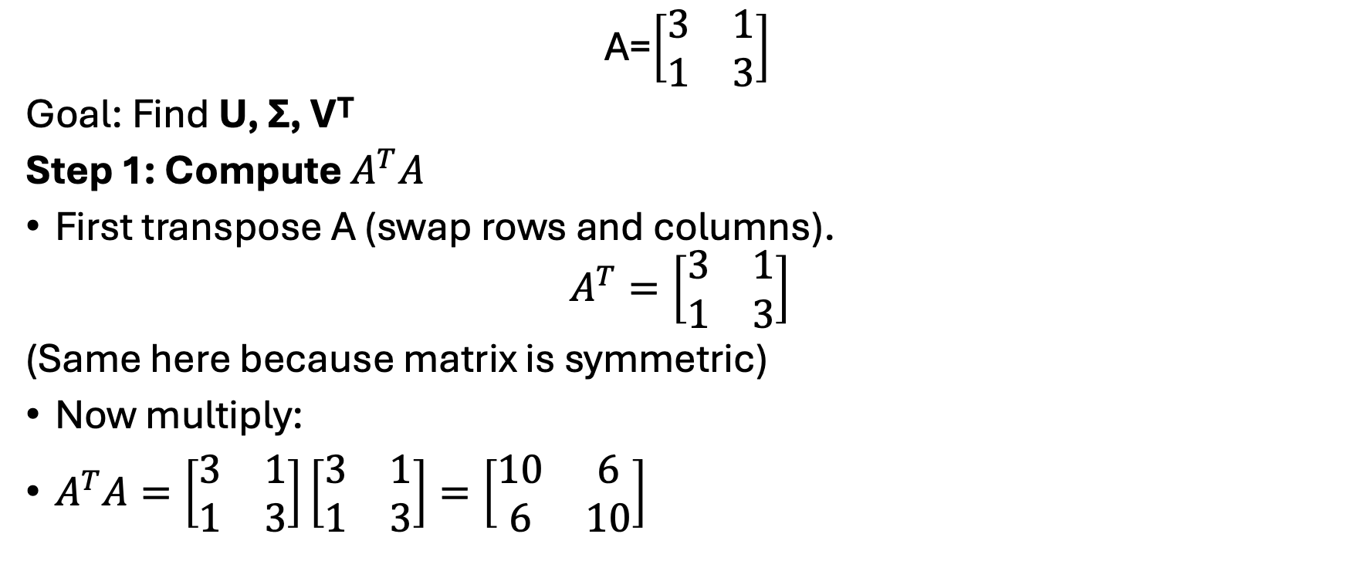
Mathematical Example: SVD
A=$\left[\begin{matrix}3 & 1 \\ 1 & 3\end{matrix}\right]$
Goal: Find U, Σ, Vᵀ
Step 1: Compute $A^{T}A$
First transpose A (swap rows and columns).
$$A^{T}=\left[\begin{matrix}3 & 1 \\ 1 & 3\end{matrix}\right]$$
(Same here because matrix is symmetric)
Now multiply:
$A^{T}A=\left[\begin{matrix}3 & 1 \\ 1 & 3\end{matrix}\right]\left[\begin{matrix}3 & 1 \\ 1 & 3\end{matrix}\right]=\left[\begin{matrix}10 & 6 \\ 6 & 10\end{matrix}\right]$

Slide 4
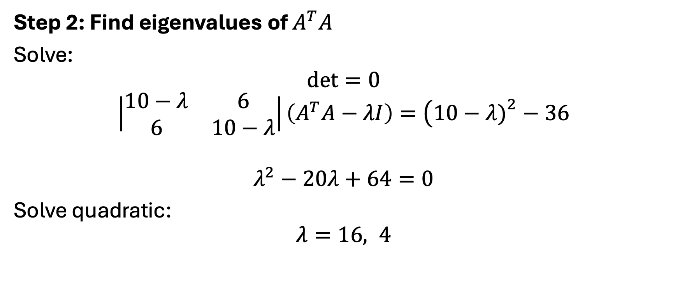
Mathematical Example: SVD
Step 2: Find eigenvalues of $A^{T}A$
Solve:
$$det⁡=0$$
$$∣\begin{matrix}10−λ & 6 \\ 6 & 10−λ\end{matrix}∣\left(A^{T}A−λI\right)=\left(10−λ{\left.)\right.}^{2}−36\right.$$
$$λ^{2}−20λ+64=0$$
Solve quadratic:
$$λ=16, 4$$

Slide 5

Mathematical Example: SVD
Step 3: Singular values
Take square roots:
$$σ_{1}=4, σ_{2}=2$$
So
$$Σ=\left[\begin{matrix}4 & 0 \\ 0 & 2\end{matrix}\right]$$

Slide 6

Mathematical Example:SVD
Step 4: Find V (eigenvectors)
Eigenvector for λ = 16, v=$\left[\begin{aligned}x \\ y\end{aligned}\right]$
Step 1: Subtract 16 from diagonal
$$B−16I=\left[\begin{matrix}10−16 & 6 \\ 6 & 10−16\end{matrix}\right]=\left[\begin{matrix}−6 & 6 \\ 6 & −6\end{matrix}\right]$$
Step 2: Solve system
$$−6x+6y=0$$
Divide by 6:
$$−x+y=0$$
$$y=x$$
Step 3: Choose simple value
Let $x=1$
$$v_{1}=\left[\begin{matrix}1 \\ 1\end{matrix}\right]$$
Step 4: Normalize (make length = 1)
Length:
$$\sqrt{1^{2}+1^{2}}=\sqrt{2}$$
Normalized eigenvector:
$$\frac{1}{\sqrt{2}}\left[\begin{matrix}1 \\ 1\end{matrix}\right]$$

Slide 7

Mathematical Example: SVD
Eigenvector for λ = 4
Step 1: Subtract 4
$$B−4I=\left[\begin{matrix}6 & 6 \\ 6 & 6\end{matrix}\right]$$
Step 2: Solve
$$6x+6y=0$$
Divide by 6:
$$x+y=0$$
$$y=−x$$
Step 3: Choose value
$$v_{2}=\left[\begin{matrix}1 \\ −1\end{matrix}\right]$$
Step 4: Normalize
Length = √2
$$\frac{1}{\sqrt{2}}\left[\begin{matrix}1 \\ −1\end{matrix}\right]$$

Slide 8
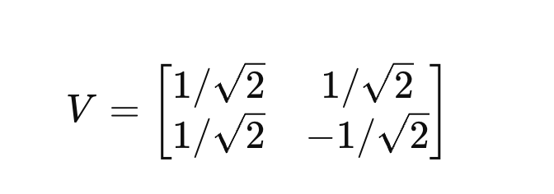
Mathematical Example: SVD
Eigen Vector

Slide 9
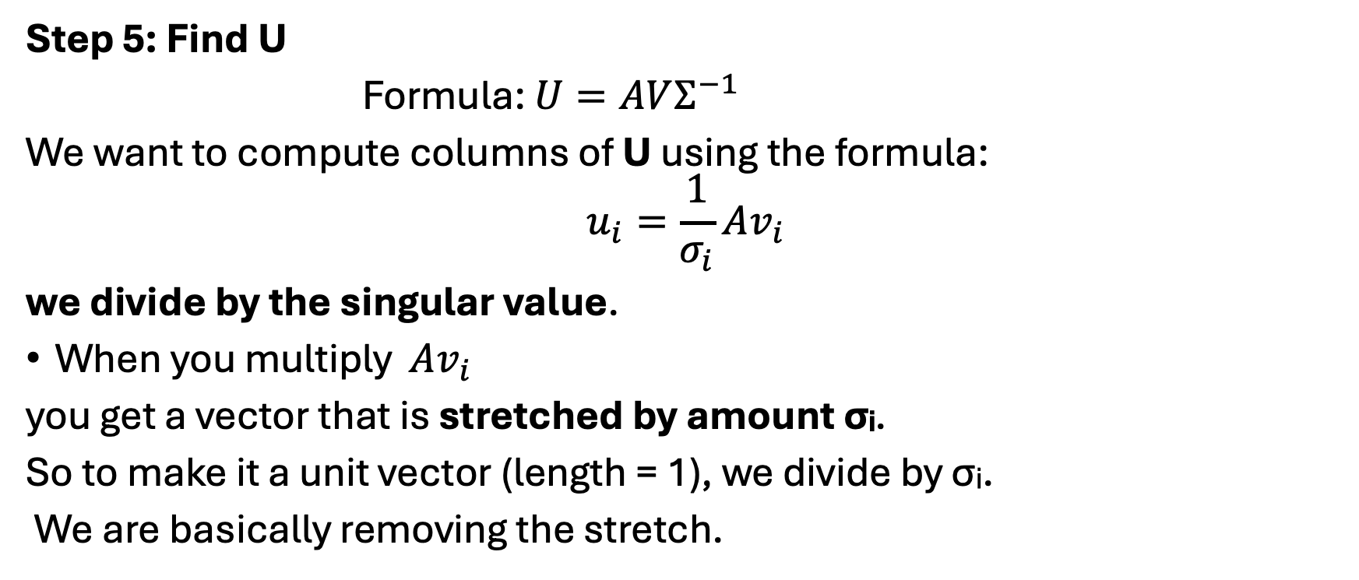
Mathematical Example: SVD
Step 5: Find U
Formula: $U=AVΣ^{−1}$
We want to compute columns of U using the formula:
$$u_{i}=\frac{1}{σ_{i}}Av_{i}$$
we divide by the singular value.
When you multiply $Av_{i}$
you get a vector that is stretched by amount σᵢ.
So to make it a unit vector (length = 1), we divide by σᵢ.
We are basically removing the stretch.

Slide 10

Mathematical Example: SVD
Matrix:
$$A=\left[\begin{matrix}3 & 1 \\ 1 & 3\end{matrix}\right]$$
Singular values:
$$σ_{1}=4, σ_{2}=2$$
Vectors:
$$v_{1}=\frac{1}{\sqrt{2}}\left[\begin{matrix}1 \\ 1\end{matrix}\right]$$
$$v_{2}=\frac{1}{\sqrt{2}}\left[\begin{matrix}1 \\ −1\end{matrix}\right]$$

Slide 11
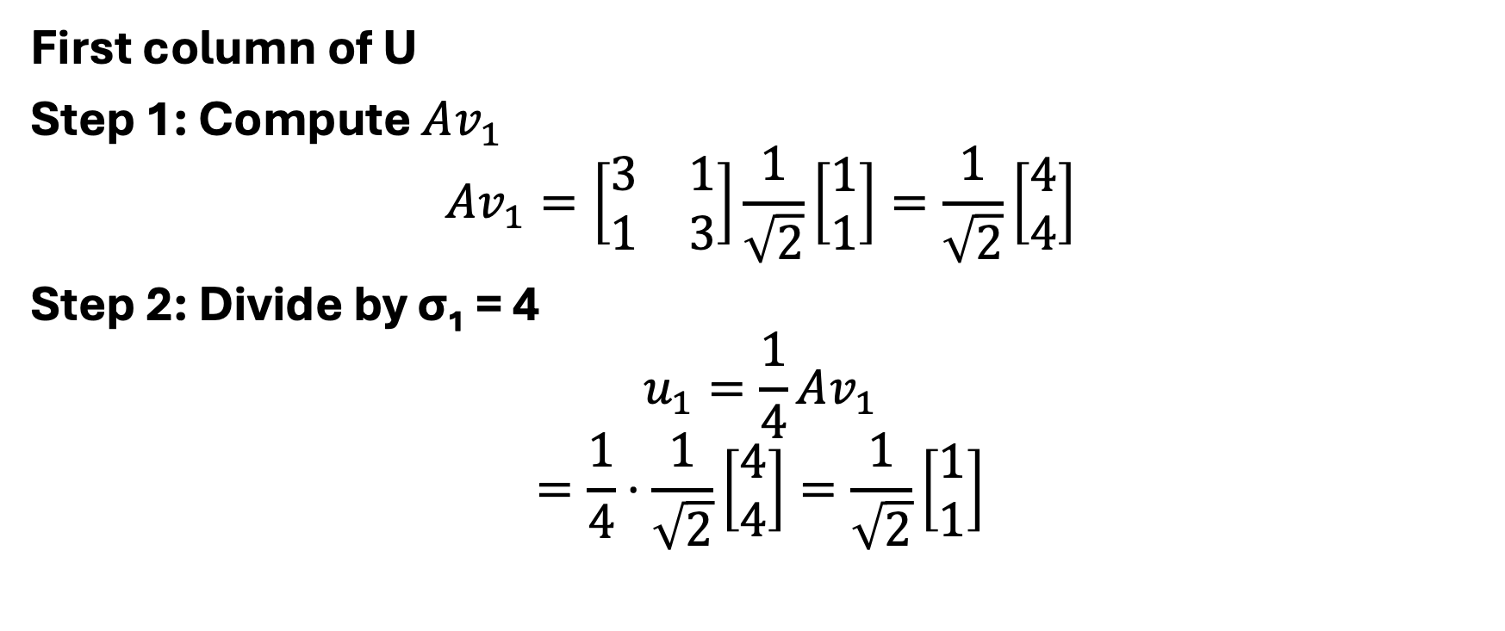
Mathematical Example: SVD
First column of U
Step 1: Compute $Av_{1}$
$$Av_{1}=\left[\begin{matrix}3 & 1 \\ 1 & 3\end{matrix}\right]\frac{1}{\sqrt{2}}\left[\begin{matrix}1 \\ 1\end{matrix}\right]=\frac{1}{\sqrt{2}}\left[\begin{matrix}4 \\ 4\end{matrix}\right]$$
Step 2: Divide by σ₁ = 4
$$u_{1}=\frac{1}{4}Av_{1}$$
$$=\frac{1}{4}⋅\frac{1}{\sqrt{2}}\left[\begin{matrix}4 \\ 4\end{matrix}\right]=\frac{1}{\sqrt{2}}\left[\begin{matrix}1 \\ 1\end{matrix}\right]$$

Slide 12
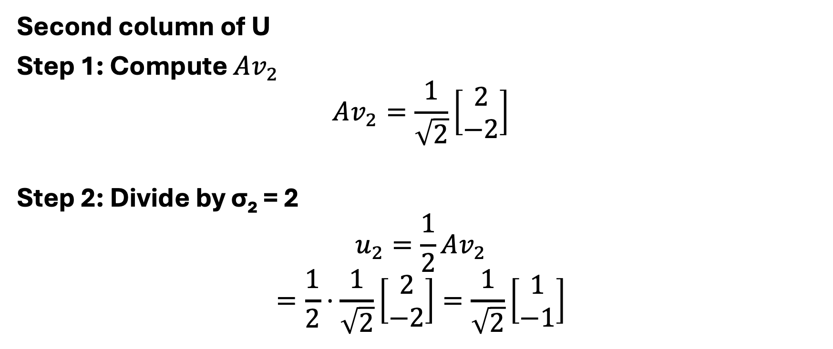
Mathematical Example: SVD
Second column of U
Step 1: Compute $Av_{2}$
$$Av_{2}=\frac{1}{\sqrt{2}}\left[\begin{matrix}2 \\ −2\end{matrix}\right]$$
Step 2: Divide by σ₂ = 2
$$u_{2}=\frac{1}{2}Av_{2}$$
$$=\frac{1}{2}⋅\frac{1}{\sqrt{2}}\left[\begin{matrix}2 \\ −2\end{matrix}\right]=\frac{1}{\sqrt{2}}\left[\begin{matrix}1 \\ −1\end{matrix}\right]$$

Slide 13
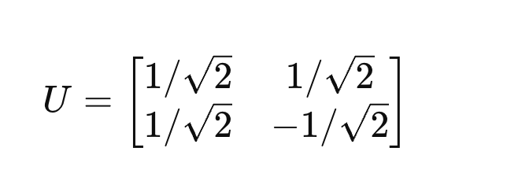
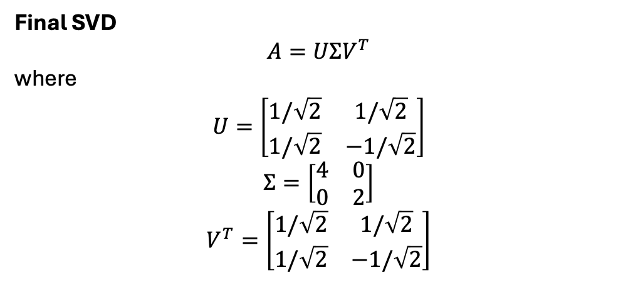
Mathematical Example: SVD
Final SVD
$$A=UΣV^{T}$$
where
$$U=\left[\begin{matrix}1/\sqrt{2} & 1/\sqrt{2} \\ 1/\sqrt{2} & −1/\sqrt{2}\end{matrix}\right]$$
$$Σ=\left[\begin{matrix}4 & 0 \\ 0 & 2\end{matrix}\right]$$
$$V^{T}=\left[\begin{matrix}1/\sqrt{2} & 1/\sqrt{2} \\ 1/\sqrt{2} & −1/\sqrt{2}\end{matrix}\right]$$

